Slide 1
Data Analysis on Netflix Movies and TV Shows
Insights and Patterns from Netflix's Content Library

Slide 2
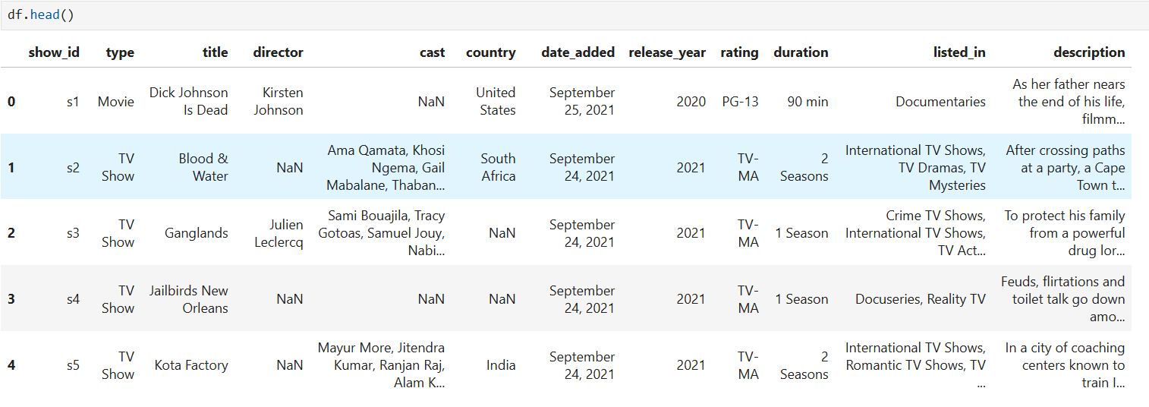
Objective: To analyze the Netflix dataset to uncover insights about its content library. To identify trends in genres, release years, content type distribution, and more.
Attributes:
Title, Type (Movie/TV Show), Release Year, Cast, Rating, Director, Country, Duration, Date Added, Description
Dataset Size: 8807 rows, 12 columns

Slide 3
Exploratary Data Analysis
Import packages
Loading data with Pandas
Descriptive statistics of data
Data visualization

Slide 4
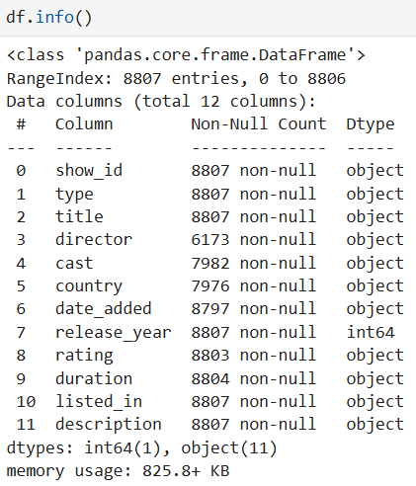
Descriptive statistics of data
Data types
It is useful to first understand the data that you're dealing with along with the data types of each column. The data types may dictate how you transform and engineer features

Slide 5
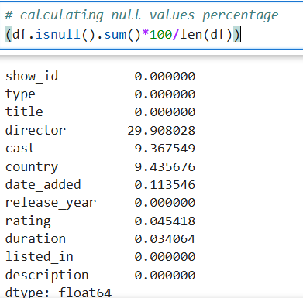
Data Cleaning
Data Cleaning involves handling missing values and inconsistent values
Converting Date Formats
Checking Duplicate Values

Slide 6
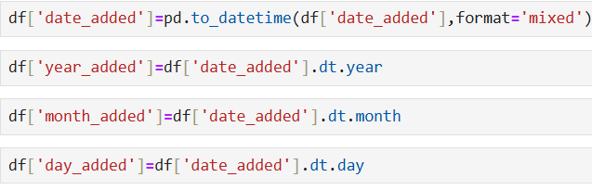
Feature Engineering
creating or transforming colums to make them more useful for analysis

Slide 7
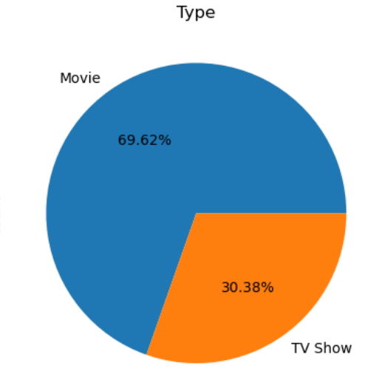
Data Visualization
To uncover patterns and trends, let’s dive deep into the dataframes using visualization techniques
This pie chart shows, which type dominates the Netflix library and almost 70% of content comes from movies

Slide 8
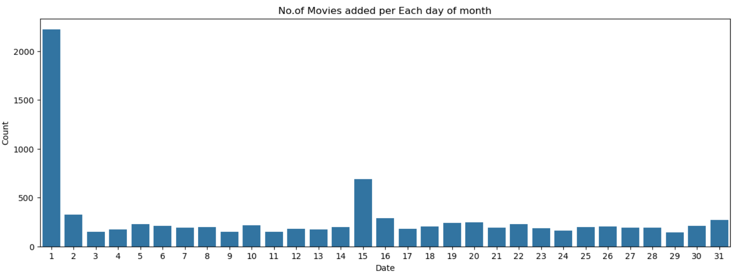
This barchart shows, which day of the month, movies are added to Netflix most often and most of the movies are added in first of the month

Slide 9
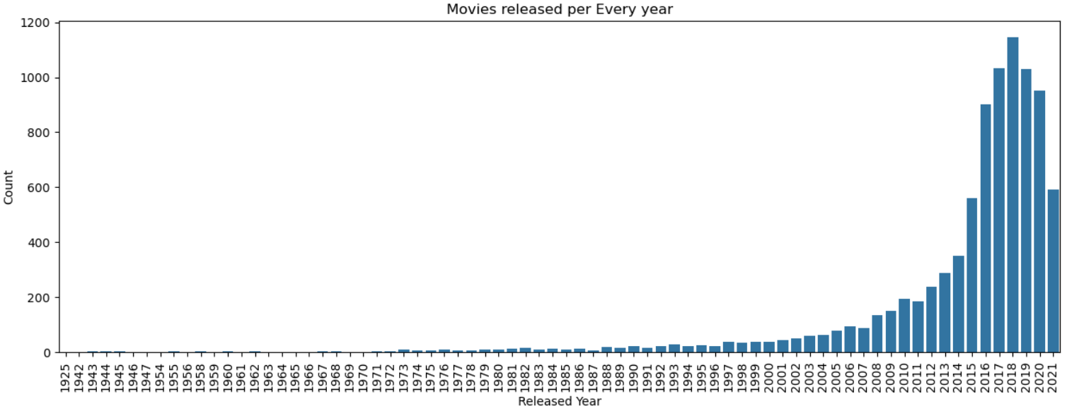
This Bar chart shows the no.of movies released per Every year and most no.of movies are released in year 2018

Slide 10
Key Findings
1.Netflix’s library has more movies than TV shows.
2.Recent years show exponential growth in content addition.
3.Netflix tends to release more movies on the first of every month

